Slide 1
Eosin-Methylene Blue
Citation: 2007. Eosin-methylene blue.
Publication Date: September 2007

Slide 2
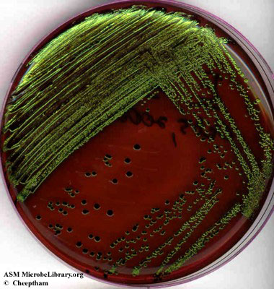
Escherichia coli on EMB (Enlarged view)
FIG. 1. Eosin-methylene blue (EMB) agar plate inoculated with Escherichia coli (a gram-negative coliform bacterium) showing good growth of dark blue-black colonies with metallic green sheen indicating vigorous fermentation of lactose and acid production which precipitates the green metallic pigment. (Naowarat Cheeptham, Thompson Rivers University, Kamloops, BC, Canada)
American Society For Microbiology ©

Slide 3
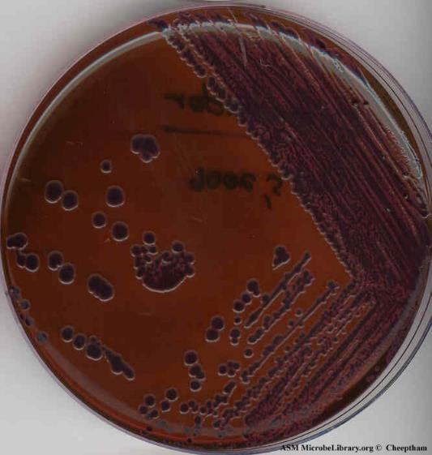
Enterobacter aerogenes on EMB (Enlarged view)
FIG. 2. EMB agar plate inoculated with Enterobacter aerogenes (a gram-negative coliform bacterium) showing good growth of brown, dark-centered, mucoid colonies indicating lactose fermentation and acid production. (Naowarat Cheeptham, Thompson Rivers University, Kamloops, BC, Canada)
American Society For Microbiology ©

Slide 4
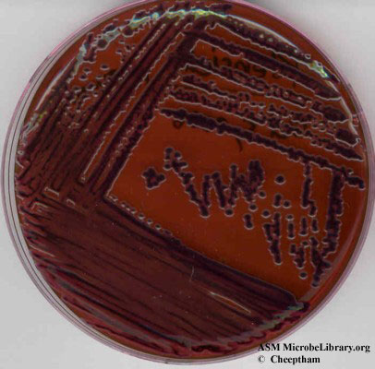
Klebsiella pneumoniae on EMB (Enlarged view)
FIG. 3. EMB agar plate inoculated with Klebsiella pneumoniae (a gram-negative coliform bacterium) showing good growth of brown, dark-centered, mucoid colonies (smaller than Enterobacter) indicating lactose fermentation and acid production. (Naowarat Cheeptham, Thompson Rivers University, Kamloops, BC, Canada)
American Society For Microbiology ©

Slide 5
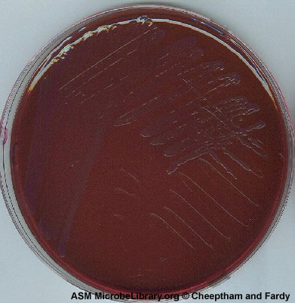
Pseudomonas aeruginosa on EMB (Enlarged view)
FIG. 4. EMB agar plate inoculated with Pseudomonas
aeruginosa (a gram-negative noncoliform bacterium) showing good growth but no fermentation of sugars or acid production. (Naowarat Cheeptham and Carolynne Fardy, Thompson Rivers University, Kamloops, BC, Canada)
American Society For Microbiology ©

Slide 6
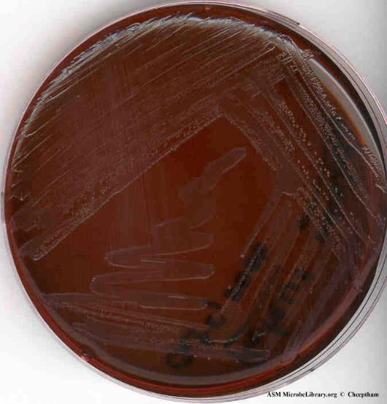
Proteus vulgaris on EMB (Enlarged view)
FIG. 5. EMB agar plate inoculated with Proteus
vulgaris (a gram-negative coliform bacterium) showing growth of pink colonies indicating non-lactose fermentation and some acid production. (Naowarat Cheeptham, Thompson Rivers University, Kamloops, BC, Canada)
American Society For Microbiology ©

Slide 7
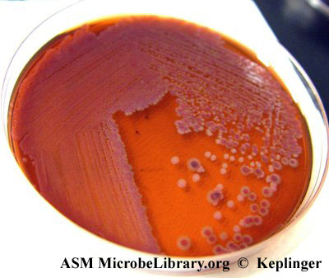
Escherichia coli and Salmonella enteritidis on EMB (Enlarged view)FIG. 9. EMB agar plate inoculated with mixed enteric flora. The lactose fermenter
Escherichia coli grew with purple-centered colonies while the lactose nonfermenter Salmonella enteritidis grew as colorless colonies. Salmonella enteritidis mixed with Escherichia coli is able to utilize the acid products as energy source, resulting in an insufficient acid buildup to precipitate out the Eosin Methylene Blue and no green metallic sheen is produced by Escherichia coli. (Jerry Keplinger, East Tennessee State University, Johnson City, TN)
American Society For Microbiology ©

Slide 8
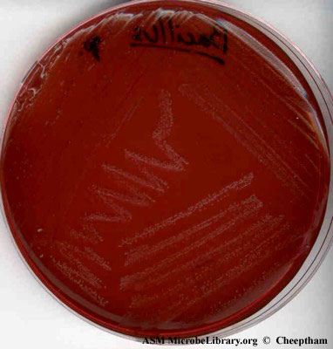
Bacillus subtilis on EMB (Enlarged view)
FIG. 11. EMB agar plate inoculated with Bacillus
subtilis (a gram-positive bacterium) showing poor growth. (Naowarat Cheeptham,Thompson Rivers University, Kamloops, BC, Canada)
American Society For Microbiology ©

Slide 9
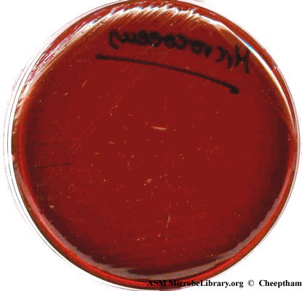
Micrococcus luteus on EMB (Enlarged view)
FIG. 12. EMB agar plate inoculated with Micrococcus
luteus (a gram-positive bacterium) showing no growth. (Naowarat Cheeptham, Thompson Rivers University, Kamloops, BC, Canada)
American Society For Microbiology ©

Slide 10
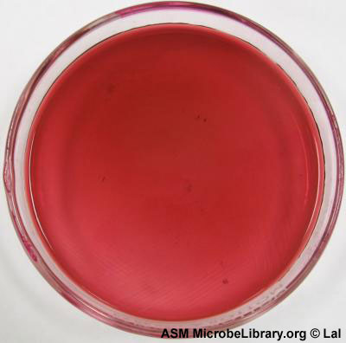
Streptococcus group B on EMB (Enlarged view)
FIG. 14. EMB agar plate inoculated with Streptococcus group B (a gram-positive bacterium) showing no growth. (Archana Lal, Independence Community College, Independence, KS)
American Society For Microbiology ©

Slide 11
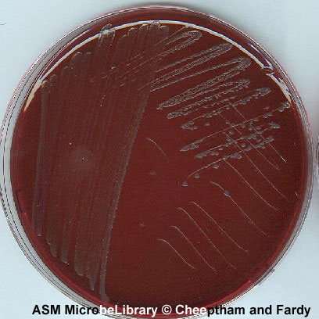
Salmonella enteritidis on EMB(Enlarged view)
FIG. 16. EMB agar plate inoculated with Salmonella enteritidis (a gram-negative coliform bacterium) showing good growth of grey mucoid colonies with no fermentation of lactose or acid production. (Naowarat Cheeptham and Carolynne Fardy, Thompson Rivers University, Kamloops, BC, Canada)
American Society For Microbiology ©

Slide 12
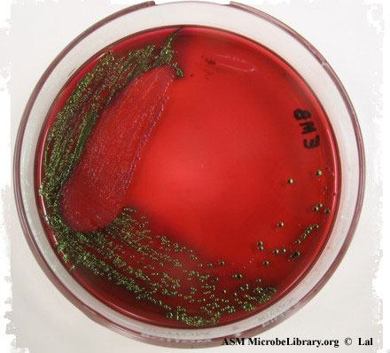
Escherichia coli and Pseudomonas aeruginosa on EMB (Enlarged view)
FIG. 6. EMB agar plate inoculated with a mixed culture of Escherichia coli and Pseudomonas aeruginosa. Note the metallic green sheen of the strong lactose-fermenting Escherichia coli and the pinkish colonies of nonfermenter Pseudomonas aeruginosa. (Archana Lal, Independence Community College, Independence, KS)
American Society For Microbiology ©

Slide 13
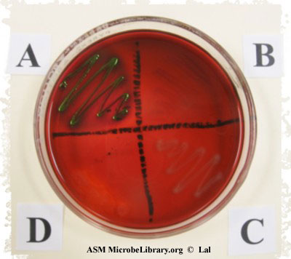
Escherichia coli, Bacillus subtilis, Pseudomonas aeruginosa, and Staphylococcus aureus on EMB (Enlarged view)
FIG. 15. EMB agar plate inoculated with (A) Escherichia coli, (B) Bacillus subtilis, (C) Pseudomonas aeruginosa, and (D) Staphylococcus aureus. The two gram-positive bacteria Bacillus subtilis and Staphylococcus aureus did not grow, while the two gram-negative bacteria Escherischia coli and Pseudomonas aeruginosa grew with typical lactose fermenter (colonies with green metallic sheen) and nonfermenter (pink colonies) morphology. (Archana Lal, Independence Community College, Independence, KS)
American Society For Microbiology ©

Slide 14
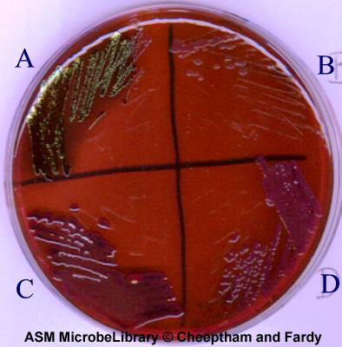
Escherichia coli, Pseudomonas aeruginosa, Klebsiella pneumoniae, Enterobacter aerogenes on EMB(Enlarged view)FIG. 17. EMB agar plate inoculated with (A) Escherichia coli, (B) Pseudomonas aeruginosa, (C) Klebsiella pneumoinae, and (D) Enterobacter aerogenes. All four gram negative bacteria grew exhibiting different morphology. Escherischia coli grew with typical lactose fermenter morphology with excessive acid production and precipitation of green metallic pigment (colonies with green metallic sheen). Pseudomonas aeruginosa grew exhibiting the nonfermenter morphology (pinkish colonies), both Klebsiella pneumoniae and Enterobacter aerogenes grew with lactose fermentation and acid production morphology (with purple dark centered mucoid colonies). (Naowarat Cheeptham and Carolynne Fardy, Thompson Rivers University, Kamloops, BC, Canada)
American Society For Microbiology ©

